Slide 1

Project 1: Ames Housing
Elvessa Tatum
UHID: 2064084
Classification

Slide 2
Our Purpose
Our goal here is to make a model that predicts if a house is expensive or not, based on the median value. This is important as people should know the kind of features that lead a house to be expensive or not. That way, they can see if a house they wish to buy has a good price based on the features it has. Or, they can put a house for sale at a good price based on these features.

Slide 3
Background info
- In this project, we’re using Logistic Regression. This is different from linear regression in that it’s used for classification problems. These classification problems help predict a probability or class label. We’ll also be using decision trees. Decision trees can help with determining the decision process that someone takes when deciding to put a home for sale or buy a home themselves.
- We should also define the difference between predictors and response variables. Predictors are input variables used to make predictions. They can be thought of as independent variables, or features of the dataset. Response variables are the output variable that we’re trying to predict. They can be thought of as a target or dependent variable
- We preprocessed the raw data to make it cleaner for analysis. It’s necessary to make sure the data is clean to avoid errors later, get rid of missing values, splitting the data for training and testing, etc..
- Overfitting is when a model learns the data too well. It typically leads to a high testing error, due to the results creating poor generalizations of the data. On the other hand, underfitting is when the model doesn’t learn the data enough. It leads to the model having a high training and testing error, thus producing bad results.

Slide 4
Data Information
This dataset contains various features and attributes of residential homes in Ames, Iowa, USA. It holds a multitude of variables, but after processing, we decided to use the following:
'Overall Qual’: Rates the overall material and finish of the house (Ordinal)
'Full Bath’: Full bathrooms above grade (Discrete)
'Year Built’: The year the house was built (Discrete)
'Garage Cars’: Size of garage in car capacity (Discrete)
'Gr Liv Area’: Above grade (ground) living area square feet (Continuous)
'Foundation’: Type of foundation (nominal)
'Exter Qual’: Evaluates the quality of the material on the exterior (Ordinal)
'Year Remod/Add’: Remodel date (same as construction date if no remodeling or additions) (Discrete)
'Garage Yr Blt’: Year the garage was built (Discrete)
'Garage Area’: Size of garage in square feet (Continuous)
'Kitchen Qual’: Kitchen Quality (Ordinal)
'Bsmt Qual’: Evaluates the height of the basement (Ordinal)
'Total Bsmt SF’: Total square feet of basement area (Continuous)
'Fireplaces’: Number of fireplaces (Discrete)
'1st Flr SF’: First Floor Square Feet (Continuous)
'Garage Type’: Garage location (Nominal)
'BsmtFin Type 1’: Rating of basement finished area (Ordinal)
'Exterior 1st’: Exterior covering on house (Nominal)
'TotRms AbvGrd’: Total rooms above grade (does not include bathrooms) (Discrete)

Slide 5
Data Info Continued
The continuous data can be summed up as: Overall Qual, Full Bath, Year Built, Garage Cars, Gr Liv Area, Year Remod/Add, Garage Yr Blt, Garage Area, Total Bsmt SF, Fireplaces, 1st Flr SF, and TotRms AbvGrd.
The categorical variables can be summed up as: Foundation, Exter Qual, Kitchen Qual, Bsmt Qual, Garage Type, BsmtFin Type 1, and Exterior 1st.
Our response variable here is “AboveMedian,” which indicates if a house is above or below the median value.

Slide 6
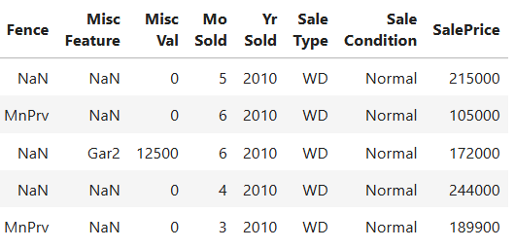
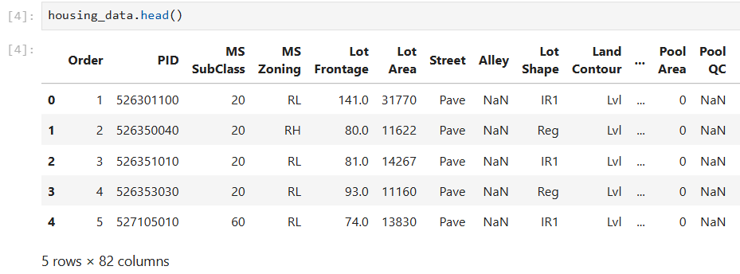
Data Exploration
Let’s look at the first 5 rows, and check for missing values

Slide 7
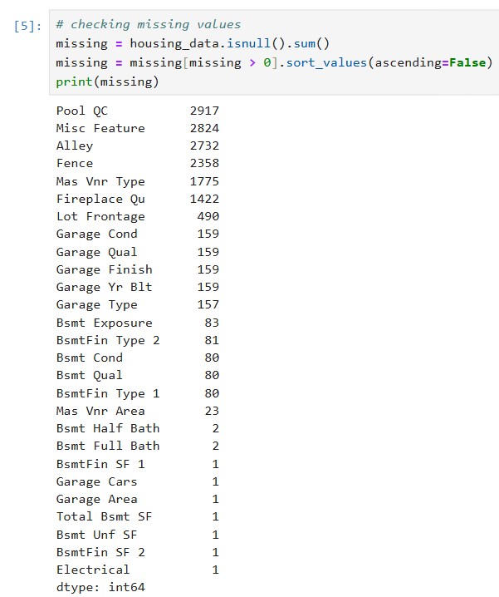
Data exploration continued

Slide 8
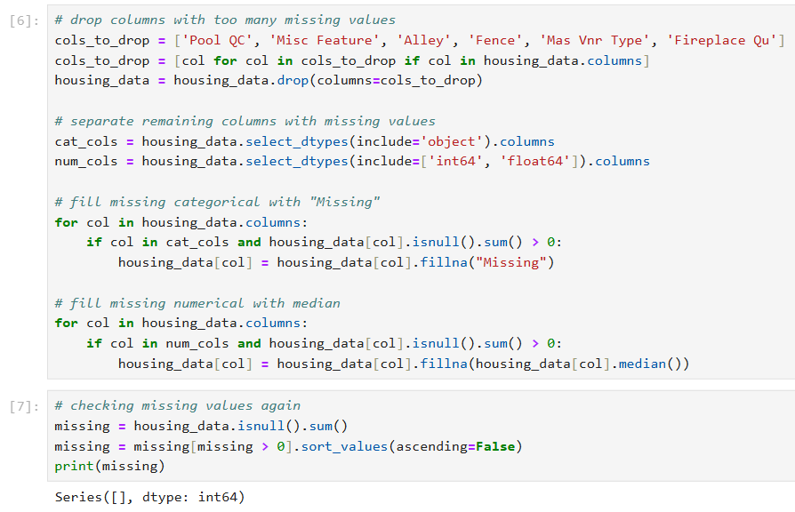
Preprocessing
Let’s deal with the missing values by filling them in or getting rid of the variables attached to them if that variable has too many missing values.

Slide 9
Preprocessing and data exploration continued
Let’s add the target variable
Then, let’s see how the data correlates with the target variable

Slide 10
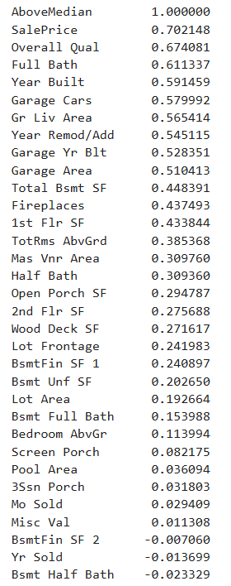
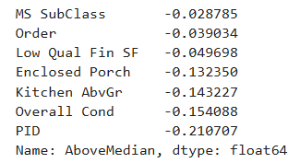
Preprocessing and data exploration continued
Clearly, the top 3 variables that allign best with the target are SalePrice, Overall Quality, and Full bath.
SalePrice was the original target in the dataset, so it should be removed from future use

Slide 11
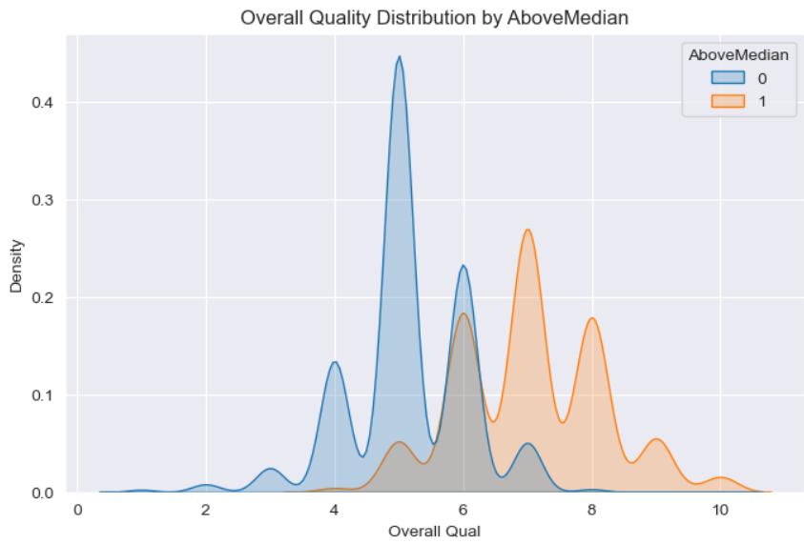
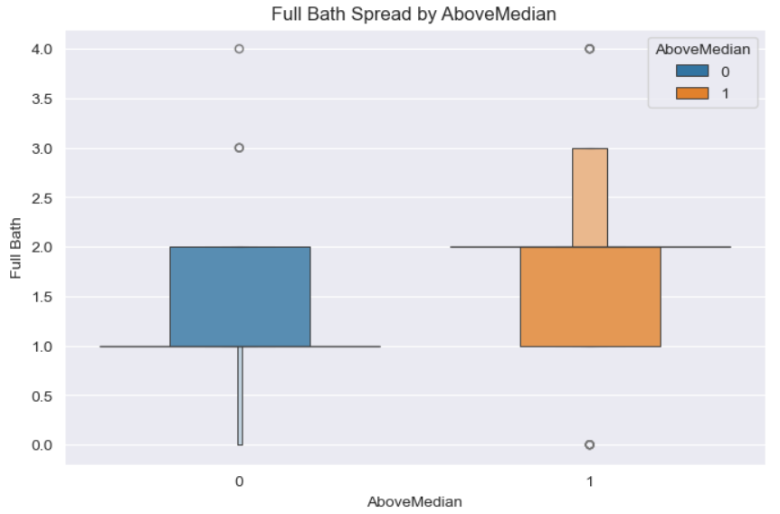
Data exploration continued
Let’s look at some plots based on what correlates with the data. Let’s look at the distribution of overall quality and full bath
From here, we can see that most houses that are below the median have 2 bathrooms and have a lesser quality. Meanwhile, houses with a higher quality and not many bathrooms are more expensive, being higher than the median.

Slide 12
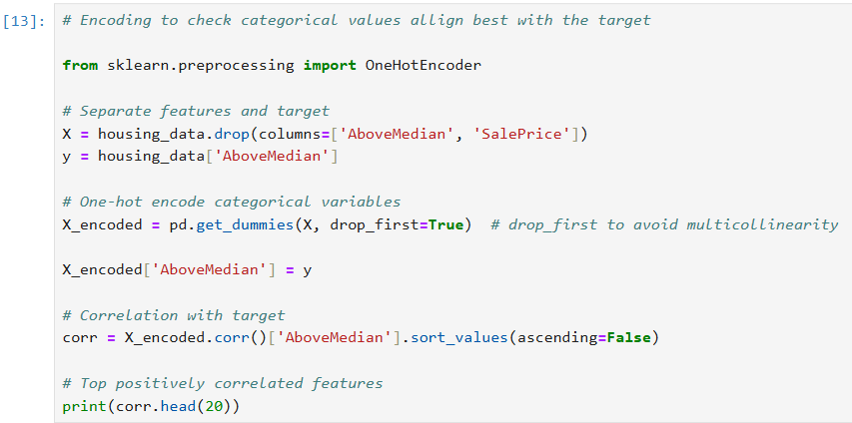
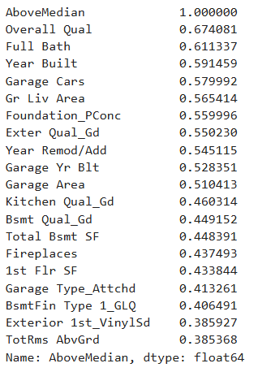
Data exploration continued
Let’s encode the data to include categorical values in our exploration, and see what are the most correlated features. After this, it is clear what columns should or shouldn't be kept. Anything above a correlation of 0.35 should be kept.

Slide 13
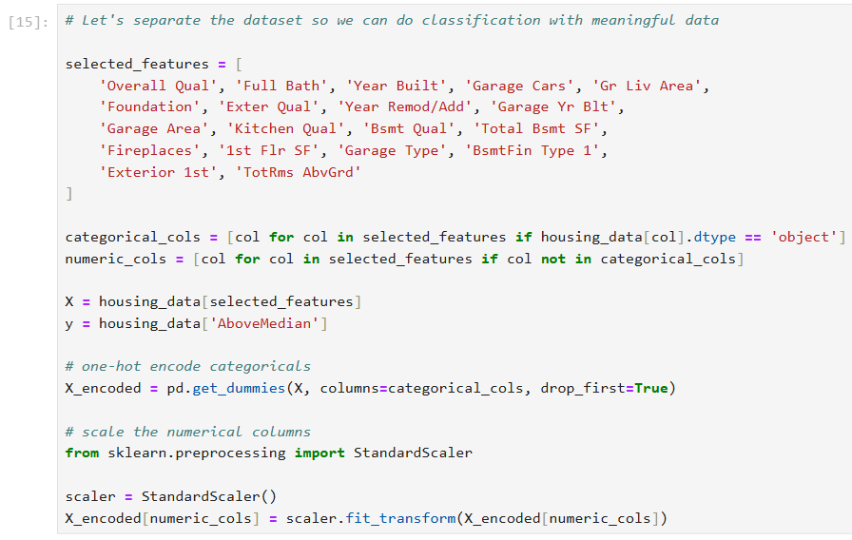
Data preprocessing continued
Let’s get the selected features, encode them, and scale and normalize them

Slide 14
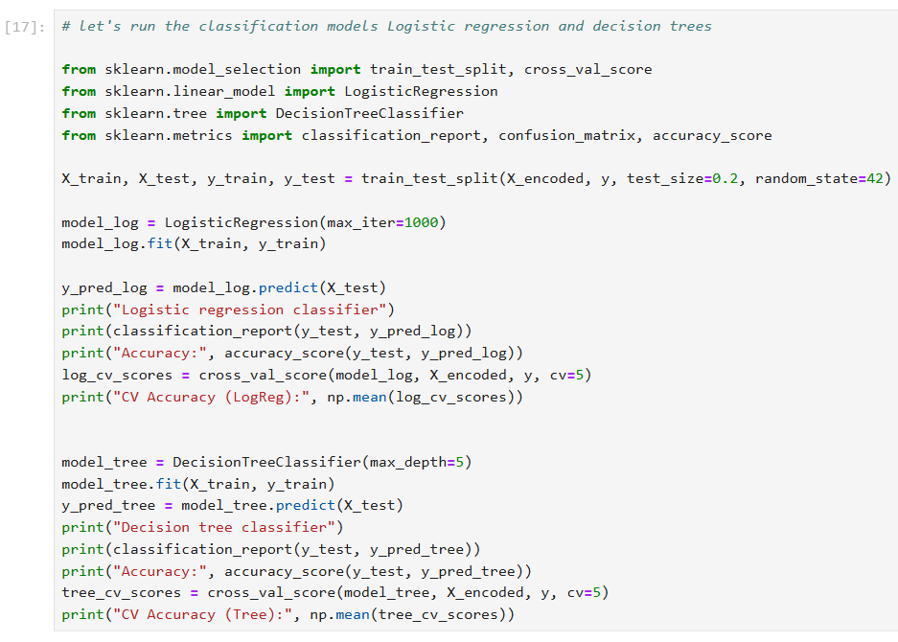
Creating the models
Let’s use logistic regression and decision trees to run our data.

Slide 15
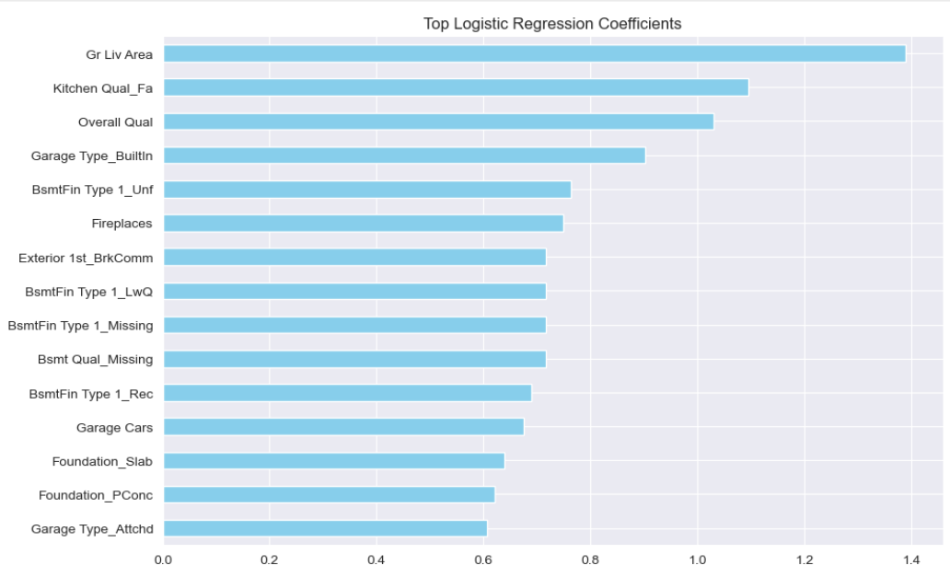
Creating the models continued
Let’s visualize our models, starting with logistic regression, then decision tree.

Slide 16
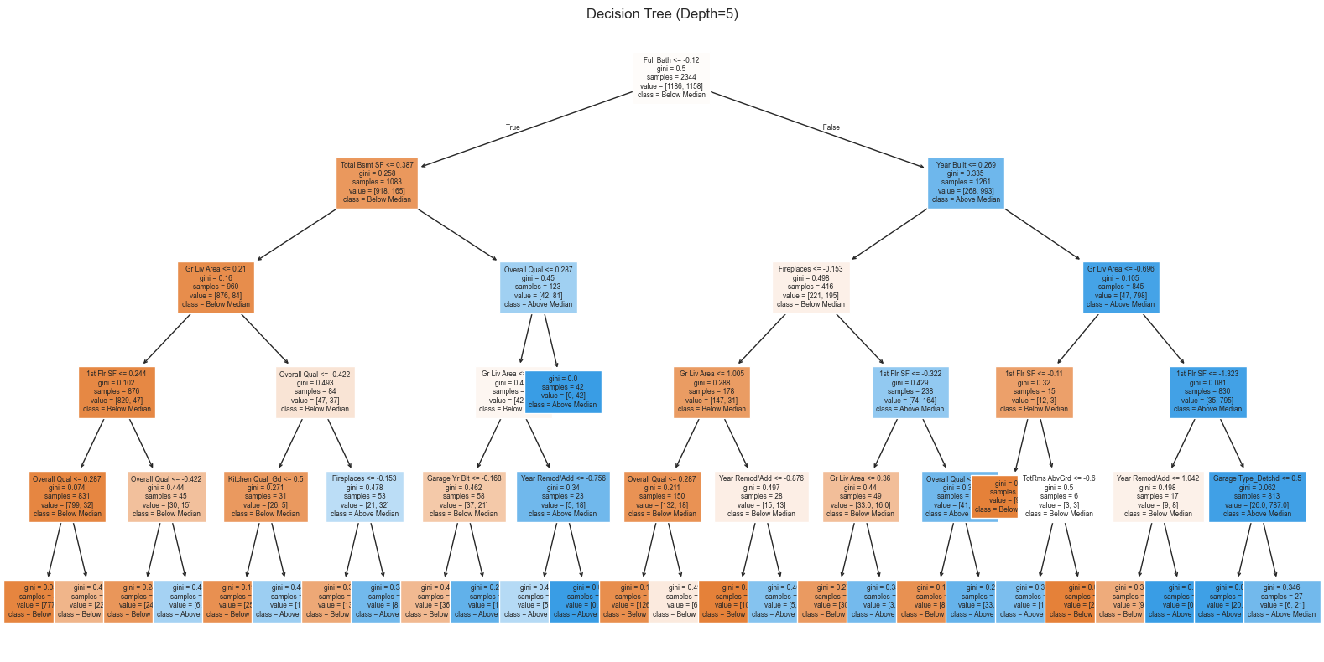
Now for decision trees

Slide 17
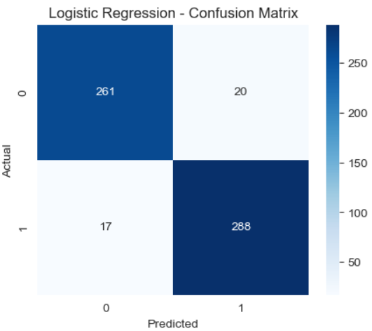
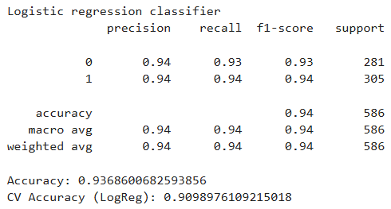
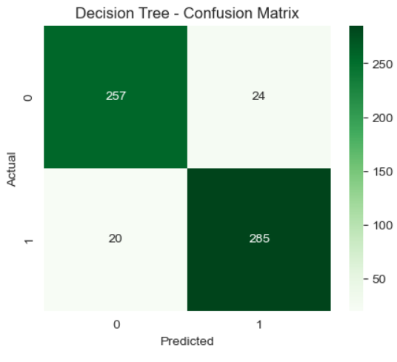
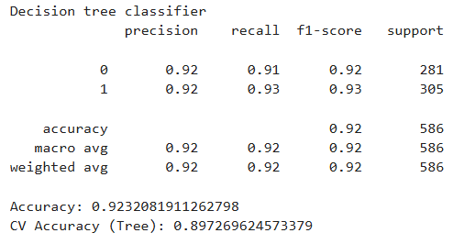
Evaluating the models
Let’s look at the classification report and confusion matrix for our models

Slide 18
Conclusion
The logistic regression model shows that the ground living area and the kitchen quality are actually more important than the overall quality of the house. This is important as it differed from what we originally saw. Originally, we saw the overall quality of the house being the most important factor, but we now know that isn’t the case. Rather, the kitchen and ground living area parts of the house are the most important
Meanwhile, the decision tree model showed that the root node was split on full bath, followed by other features like Overall Quality, Year Built, Fireplaces, and ground living area. This builds on what we saw before, which is that the ground living area is one of, if not the most important feature in whether a house is above or below the median value.
With these results, people are able to understand what exactly leads a house to be above or below median value. With this information, people can determine how much to sell or buy a house for, based on the important features such as the overall quality of the house, the number of bathrooms, and the ground living area.
Both models did extremely well, with an accuracy of 0.94 for the logistic regression model and an accuracy of 0.92 for the decision tree model. Even with cross validation, both models had an accuracy of about 0.9. This means that the model is accurate even on unseen data.
I would expand upon this by using different models (maybe random forest instead of decision trees) or changing how much data is used for training vs testing.

